Slide 1


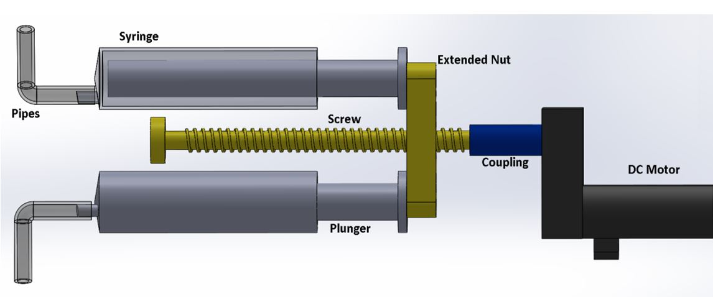
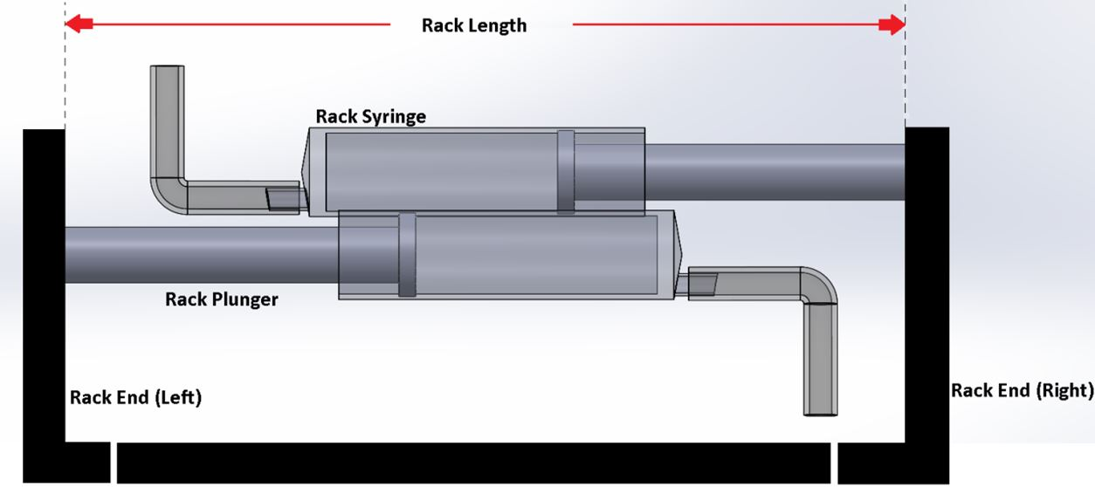
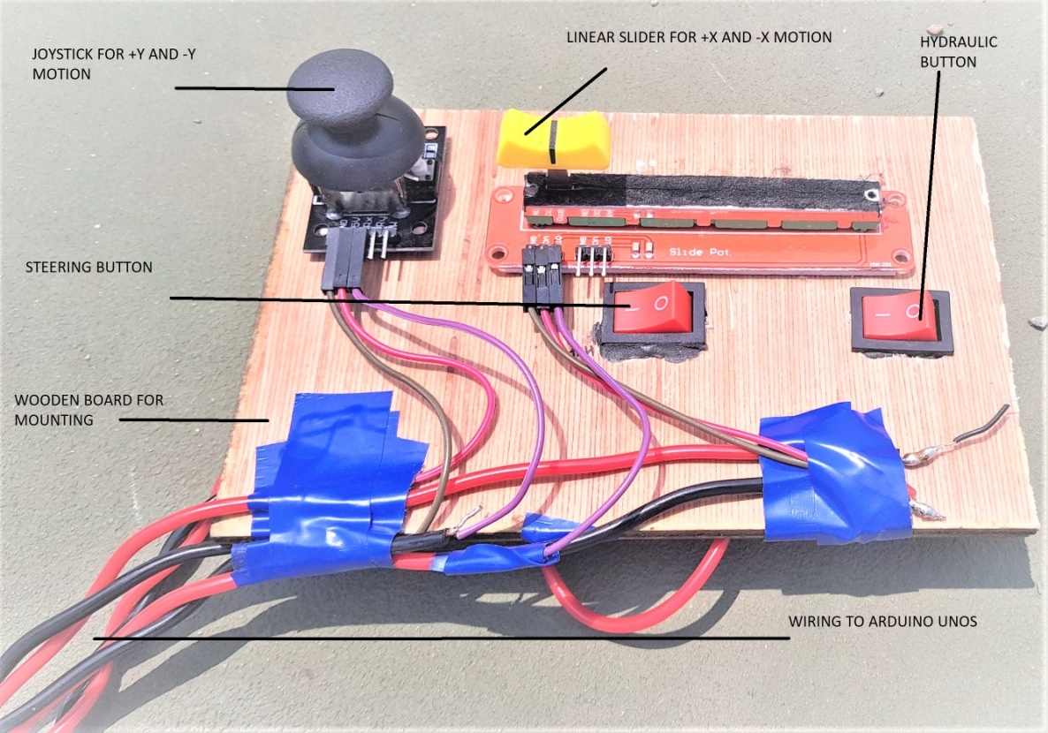
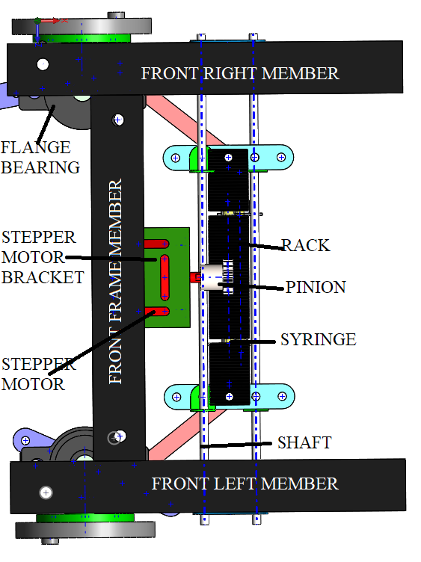
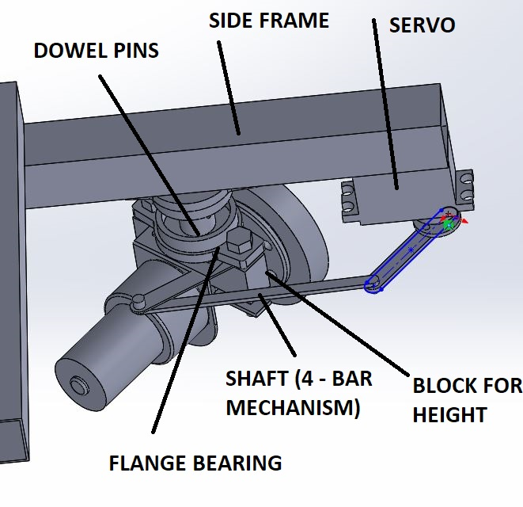
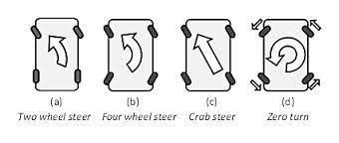
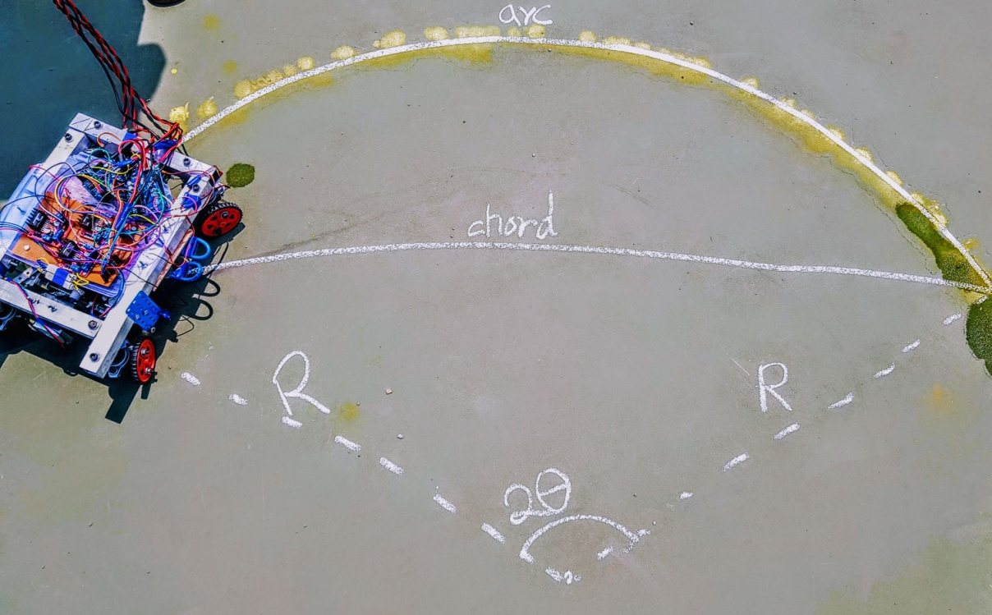
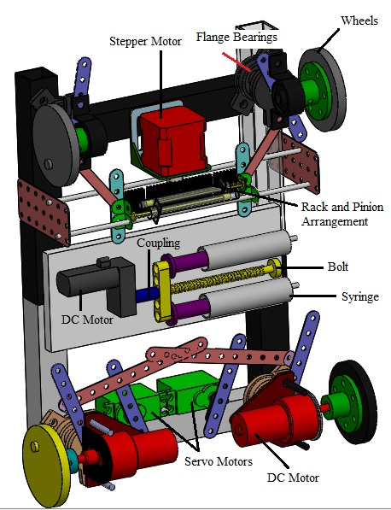
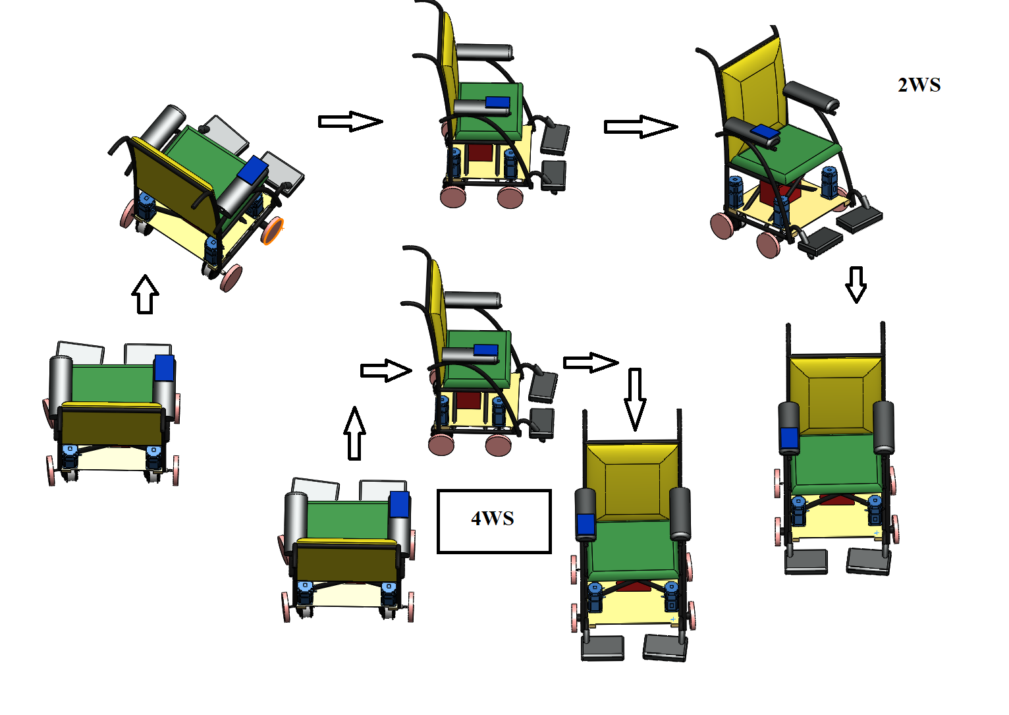
Advanced All Wheel Steering System for Low Speed Applications
Shreyas Shanker, Govind Ajith Kumar, Saksham Verma
B.Tech with specialization in Automotive Engineering, VIT
ABSTRACT :
The steering system is of utmost importance to any mode of transportation. They are further brought into the limelight by the requirements of the modern age with shrinking spaces that a vehicle may have to manoeuvre into. The toe of each wheel can be controlled independently using a controller coupled with servo motors or even a traditional Ackermann steering system whose rack length is extendable. In this poster we depict quantitative advantages of having a steering mechanism attached to all four wheel of the vehicle in terms of reduction of Turning Circle Radius which have immense advantage to the driver in any typical scenario. The results are hypothesised using simulations conducted on MATLAB R2018a as per a modified Ackerman Steering Principle and verified on a purpose built prototype
INTRODUCTION:
Advanced Steering system on a vehicle implies the steering is actively assisted by more than one axle. In this case we assume a total of two axles as is the most common example
Types of steering modes:
a)Conventional Steering: Vehicle is steered by wheels of only one axle
b)Counter-phase Steering: Vehicle is steered by both axles where both wheel move in the opposite sense of rotation sense of rotation
c)In-phase Steering: Vehicle is steered by both axles where both wheel move in the same sense of rotation
d)Zero-Turn Steer: Vehicle turns about its own vertical axis while all the wheels point to it’s inwards
REFERENCES
C. Johanson, Auto suspension and steering, 4th edition, The Goodheart Willcox 2015
W.F. Milliken, Race Car Vehicle Dynamics, SAE International, 2003, 1995
W.H.O “Guidelines on the provision of manual wheelchairs in less resourced settings” WHO, Geneva, 2008
Nick, www.supercars.net 25 February 2016 [Online] [Accessed December 18]
P Amol, “Study of Four Wheel Steering Mechanism, “International Journal of Modern Engineering Research, vol.6, no.19, pp.31-34 2016
Working of Prototype:
Hydraulic System is used to alter the length of the rack as required to switch between various steering modes
Uniquely suited for the purpose of the prototype
Easily incorporated with vehicles which already utilise pressurised liquids
Prototype is controlled by
joystick(Forwards and backwards),
Slider (Steering input) and
buttons(Steering mode)
Front end steering is a Ackermann system with variable rack length
Rack length is maintained by incompressibility of hydraulic fluid
Rear end steering is handled by a servo motor couple to the wheel via a four bar mechanism
The vehicle was attached with a reservoir to drip water onto the tyres, which can trace the desired path
Arc and chord measurements are recorded
Radius of the circle is calculated from the arc length (l) and the length of the chord (c).
A maximum reduction percentage of 63.82 % and a minimum reduction of 49.10 % are observed.
The Prototype is capable of executing all of the advanced steering functions mentioned.
Front wheels are steered by a Ackermann steering mechanism
Rear wheel are steered by servo motors and driven by DC motors
Precise angles of each wheel is calculated by on-board Arduino according to slider input
Zero Turn Steer mode is achieved by extendible rack attached to hydraulic system
This steering design was applied to design a wheelchair
practical benefits for the user as mentioned previously
Increase the accessibility of the user
Help to navigate narrow corridors and in tiny spaces like a hospital or bathroom

